Slide 1


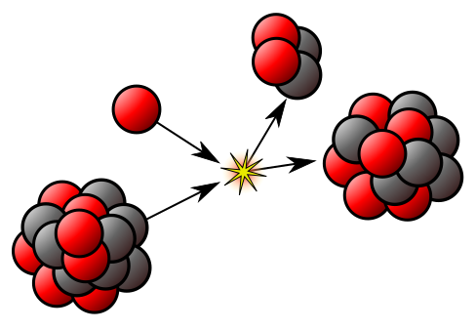
Medical physics –first year
L30-Radioactivity
By Assistants professor
Dr. Mohammed Ali Jaber
Physiology Department
College of Medicine
University of Basrah

Slide 2
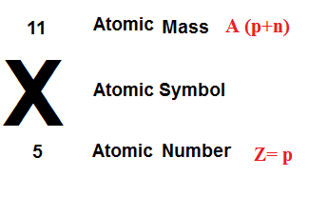
Introduction
A particular nucleus represent by the symbol
X = chemical element
A = the mass number (atomic weight )
= No. of proton +No. of neutron
Z = atomic number = No. of proton
Example ₁₁Na²³
Atomic weight=23
No. of protons = 11 ,
No. of neutron = 23-11=12

Slide 3
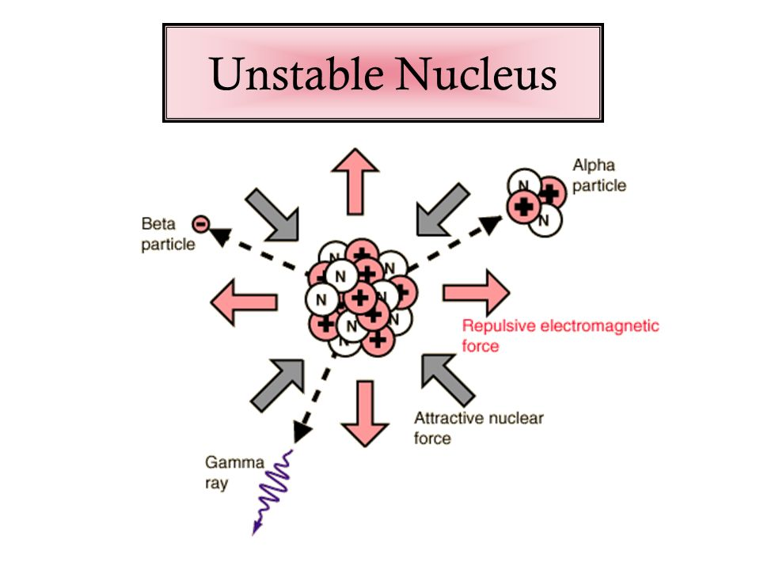
Radiation: is the energy or particles that released during radioactive decay.
What is radioactivity?
➢When the binding energy is not strong enough to hold the nucleus of an atom together, is said to be unstable.
➢Atoms with unstable nuclei are constantly changing as a result of imbalance of energy within the nucleus.
➢When the nucleus losses a neutron it gives off and is said to be radioactive.

Slide 4
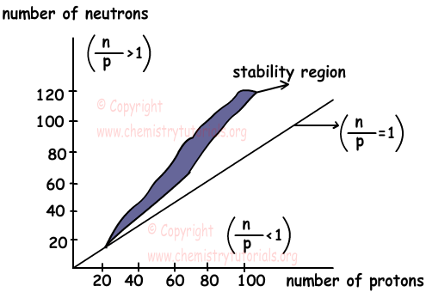
Stability of nucleus
The primary factor in determining an atom's stability is neutron to proton ratio
Stable nuclei with atomic numbers up to about 20 have an n/p ratio of about 1/1.

Slide 5
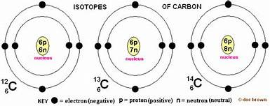
Isotope: nuclides of the same chemical element with different No. of neutrons called the isotope of that element
For example: carbon has two stable isotopes (₆C¹² , ₆C¹³ ) and several radioisotopes (₆C¹⁰ , ₆C¹¹ , ₆C¹⁴, ₆C¹⁵ )
If they are not radioactive they are called stable isotopes
If they are radioactive they are called radioisotopes

Slide 6
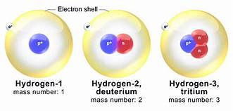
3 isotope for Hydrogen: ₁H¹ hydrogen ₁H² deuterium ₁H³ tritium
Extremely small quantities of radioactive substances used in nuclear medicine for diagnostic (typically less than1μg ) which do not affect the normal physiological functioning of the body. These radioactive elements will behave physiologically like its stable counterpart.

Slide 7
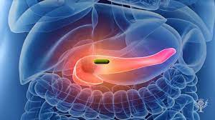
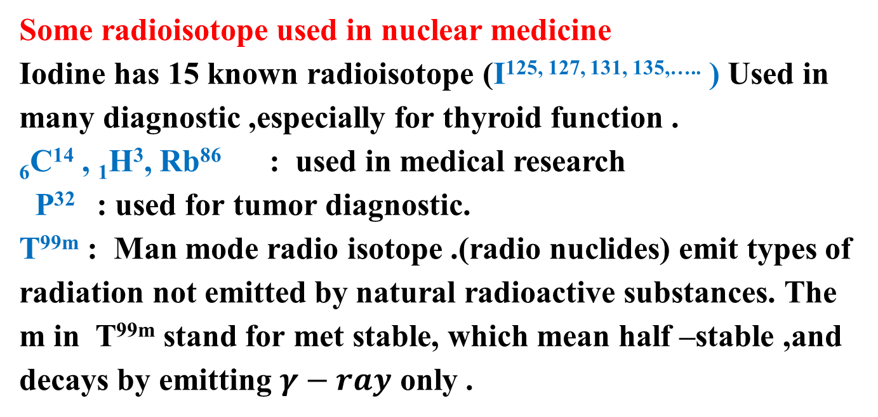
Some radioisotope used in nuclear medicine
Iodine has 15 known radioisotope (I^{125, 127, 131, 135,…..} ) Used in many diagnostic ,especially for thyroid function .
₆C¹⁴ , ₁H³, Rb⁸⁶ : used in medical research
P³² : used for tumor diagnostic.
T^{99m} : Man mode radio isotope .(radio nuclides) emit types of radiation not emitted by natural radioactive substances. The m in T^{99m} stand for met stable, which mean half –stable ,and decays by emitting $γ−ray$ only .

Slide 8
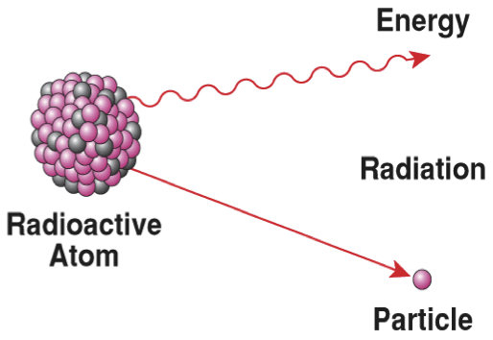
Radioactivity is the process by which a nucleus of an unstable atom loses energy by emitting particles of ionizing radiation,
As each nucleus disintegrates, in its effort to find a more stable combination, it emits a charged particle that, because of its kinetic energy, is capable of penetrating solid material.

Slide 9
Units of radioactivity:
The amount of radioactivity is measured in units of curie (ci), A curie is equal to 3.7 × 1010 disintegrations per second.
A smaller unit, the millicurie (mci), is routinely used in the field of radiologic physics.
The SI unit of radioactivity is the Becquerel. It is equal to 1 disintegration/s, typically denoted as the reciprocal of 1 second (s-1).

Slide 10
Physics of Nuclear medicine
Unstable nuclei decay by emitting α- or β-particles or γ-rays.
1. α-particle is actually a helium atom that has been stripped of its electrons and consists of two protons and two neutrons.
Heavy (4 AMU).
Typical Energy = 4-8 MeV;
Limited range (<10cm in air; 60µm in tissue);
High LET (Quality Factor QF=20) causing heavy damage (4K-9K ion pairs/µm in tissue).
Easily shielded (e.g., paper, skin) so an internal radiation hazard.
Eventually lose too much energy to ionize; become He

Slide 11
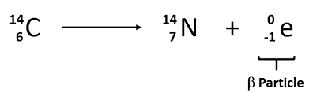
. β-particle
A negative β-particle (β⁻) carrying a unit negative charge (−1e) is called anegatron;
a positive β-particle (β⁺) carrying a unit positive charge (+1e) is called apositron.
High speed electron ejected from nucleus; -1 charge,
Light 0.00055 AMU;
Typical Energy = several KeV to 5 MeV;
Range approx. 12mm/MeV in air, a few mm in tissue;
Low LET (QF=1) causing light damage (6-8 ion pairs/µm in tissue).

Slide 12
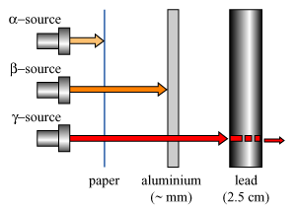
Primarily an internal hazard, but high beta can be an external hazard to skin.
Aluminum and other light (<14) materials and organo-plastics are used for shielding.
Note: Beta particles with an opposite (+) charge are called positrons. These quickly are annihilated by combination with an electron, resulting in gamma radiation (Pair Production ).

Slide 13
3. Neutrons:
Neutron ejected from a nucleus; 1 AMU; 0 Charge; Free neutrons are unstable and decay by Beta emission (electron and proton separate) with T_{½} of approx. 13 min.
Range and LET are dependent on "speed": Slow (<10 KeV), "Thermal" neutrons, QF=3, and Fast (>10 KeV), QF=10.
Shielded in stages:
High speed neutrons are "thermalized" by elastic collisions in hydrogenous materials (e.g., water, paraffin, concrete). The nuclei which are "hit" give off the excess energy as secondary radiation (alpha, beta, or gamma).
**Slow neutrons are captured by secondary shielding materials (e.g., boron or cadmium).

Slide 14
4. X- and Gamma Rays:
X-rays are photons (Electromagnetic or EM radiations) emitted from electron orbits, such as when an excited orbital electron "falls" back to a lower energy orbit;
Gamma rays are photons emitted from the nucleus, often as part of radioactive decay.
Gamma rays typically have higher energy (Mev's) than X-rays (KeV's), but both are unlimited.
No mass; Charge=0; Speed = C; Long range (km in air, m in body);
light damage (QF = 1); An external hazard (>70 KeV penetrates tissue);
In addition, the high speed electrons may lose energy in the form of X-rays when they quickly decelerate upon striking a heavy material. This is called Bremsstralung (or Breaking) Radiation.
Usually shielded with lead or concrete

Slide 15
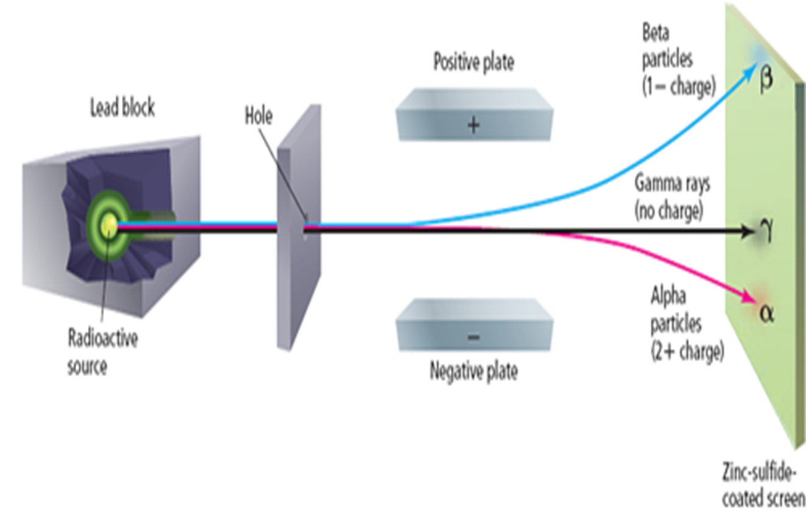
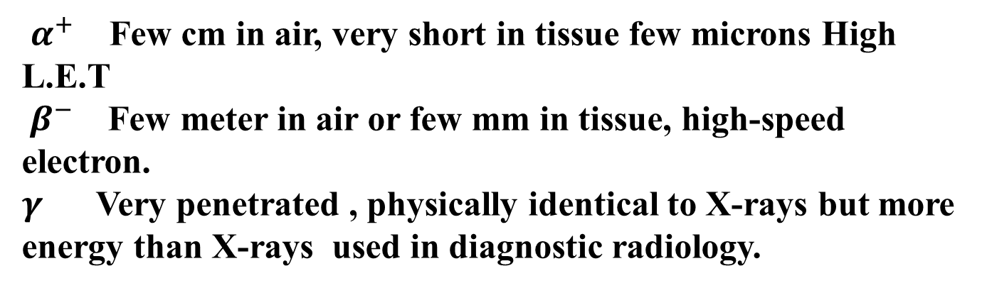
$α^{+}$ Few cm in air, very short in tissue few microns High L.E.T
$β^{−}$ Few meter in air or few mm in tissue, high-speed electron.
$γ$ Very penetrated , physically identical to X-rays but more energy than X-rays used in diagnostic radiology.

Slide 16
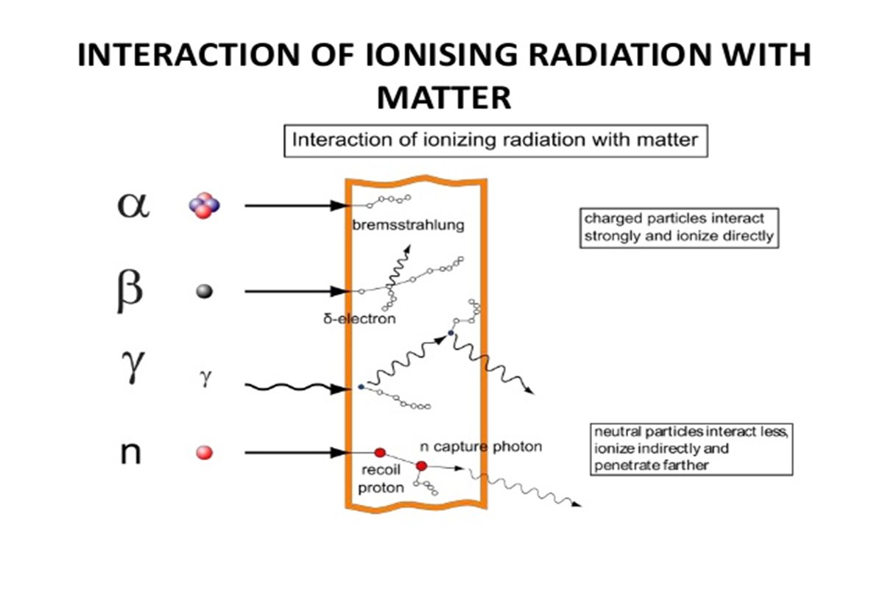
Biological effect of ionizing Radiation
The Biological effect of ionizing Radiation caused by the absorption and distribution of the energy in the tissue.
If the radiation were to pass straight through living material without leaving any energy behind , it would have NO biological effect

Slide 17
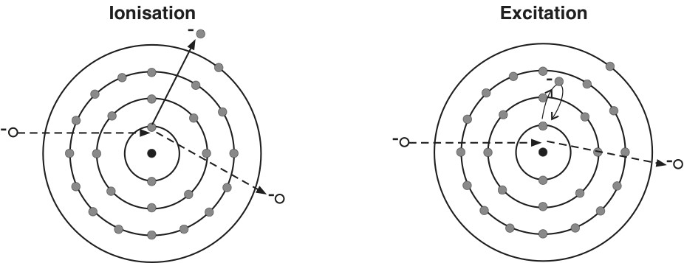
The absorption of α- particles :
Composed
α= 2n+2p
Massα m=6.7 ×10⁻²⁷ Kg.
= 7500 time is heavy as an electron
m_{e}=9.1×10⁻³¹ Kg.
Ionization and Excitation for α-particles
Excitation and ionization are the most important ways in which α- particles transfer their energy to the matter.

Slide 18
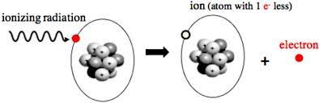
Ionization
Positively charged exerts a strong attractive force on the negatively charged orbital electrons of the atoms in its track ,may pull one or more of these electrons , this required energy for such interaction causes the dissipation of some of the energy of –particles.
A positive ion left behind an (ion pair) (ionization) ( 34 ev K.E. caused one ion pair . 1ev = 1.6 jouls

Slide 19
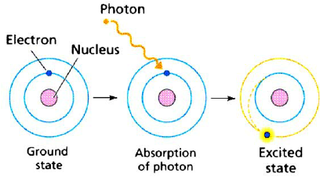
Excitation :
Rising of the inner orbital electrons to higher energy level within the atom. It does not involve the removal of electrons from the atoms

Slide 20
Specific ionization(or linear ion density)
The no. of ion pairs formed per unit length of α – particles track, and depends on
The charge ,
The density ,
Atomic no. Z of tissue
The no. of ion pairs produced is directly proportional to the initial energy of the particles.
The rate at which α - particles lost energy along the track is proportional to the square of the α - particles charge:
dE/ dX ~ (α-charge )²
where dE : energy , dX : path length

Slide 21
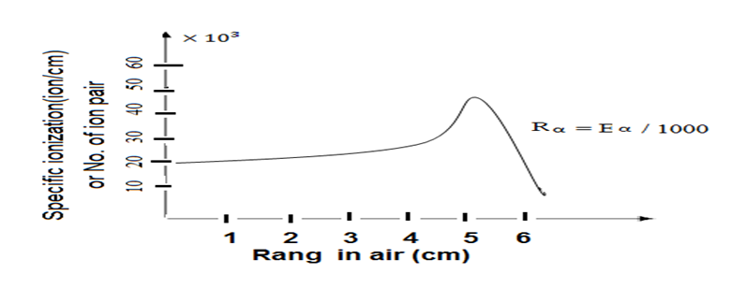
deeper penetration of α into tissue more and more interaction (ionization , excitation ) occur
Lead to reducing α –particles speed and increases the chances of further interactions. (1 Mev)_{α} few cm in air , few micrometer in dens tissue (shorter truck more damaging biologically)
Faster moving particles is less likely to ionize media through which it is passing than a slower one
i.e dE/ dX ~ 1/E dE/ dX :rate of energy loss

Slide 22
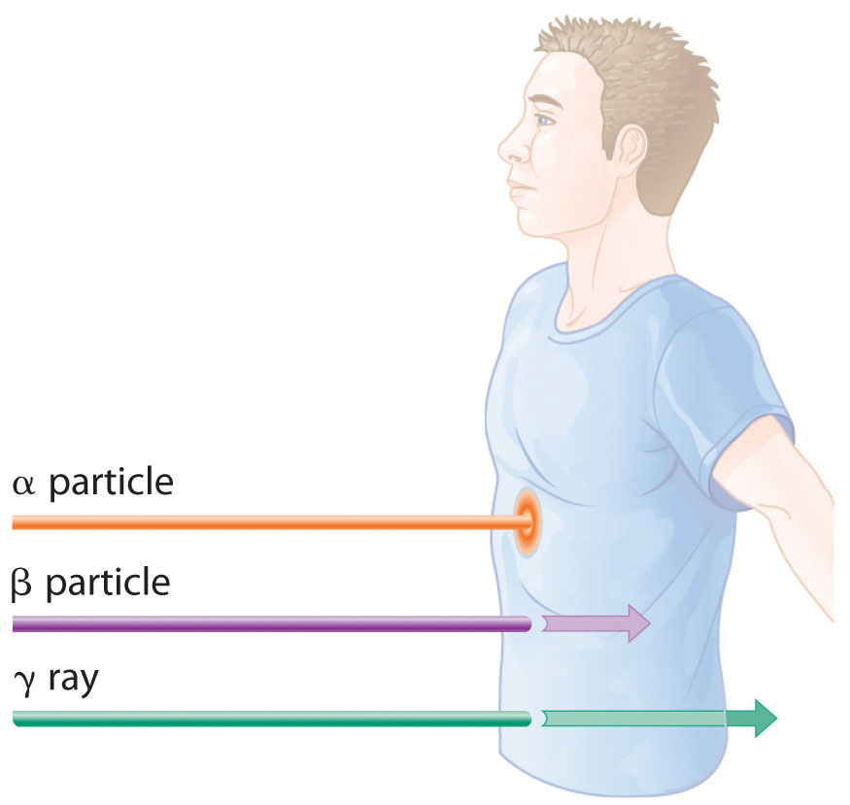
Biological effects of alpha particles
Due to the short range of absorption and inability to penetrate the outer layers of skin, alpha particles are not, in general, dangerous to life unless the source is ingested or inhaled, in which case they become extremely dangerous.

Slide 23
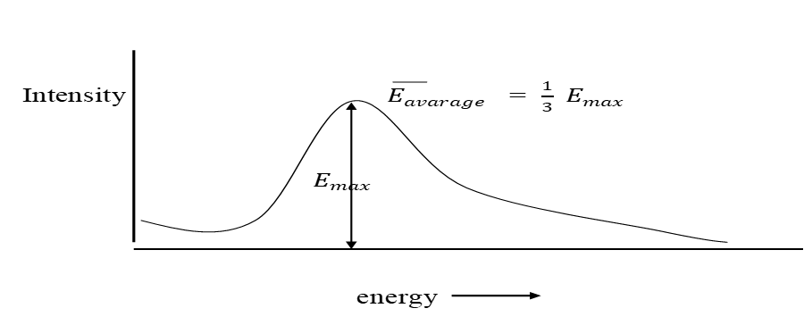
2- The absorption of electrons (β-particles)
Excitation and ionization occur as described for α –particles.
Due to its small mass and single –ve charge , it is deflected from orbital electrons path.
Greater density of ionization occur at the end of the track of the electrons .
low energy (small K.E.) (low velocity ) slowing down increases the probability of interaction (ionizeation , excitation) with media.
α and β from a given sources have fixed energies .
β-ray have a spread energies up to a maximum characteristic the sources.
Range of β-particle R= 1/2 Emax g/cm2
Penetration depth t = R/ ρ where ρ : is density of material

Slide 24
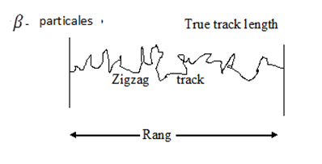
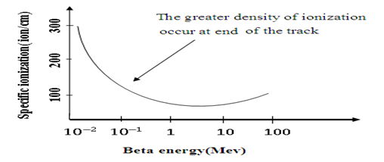
Example : What is the range of a S³⁵ beta particle of max. energy ( 0.168 Mev) in Perspex if the density of Perspex (1.2 g/cm³).Find the penetration depth.
Range of β-particle R= 1/2 Emax = 0.168/2 = 0.084 gm/cm2
Penetration depth t = R/ ρ = 0.084/1.2 = 0.07 cm = 0.7 mm

Slide 25
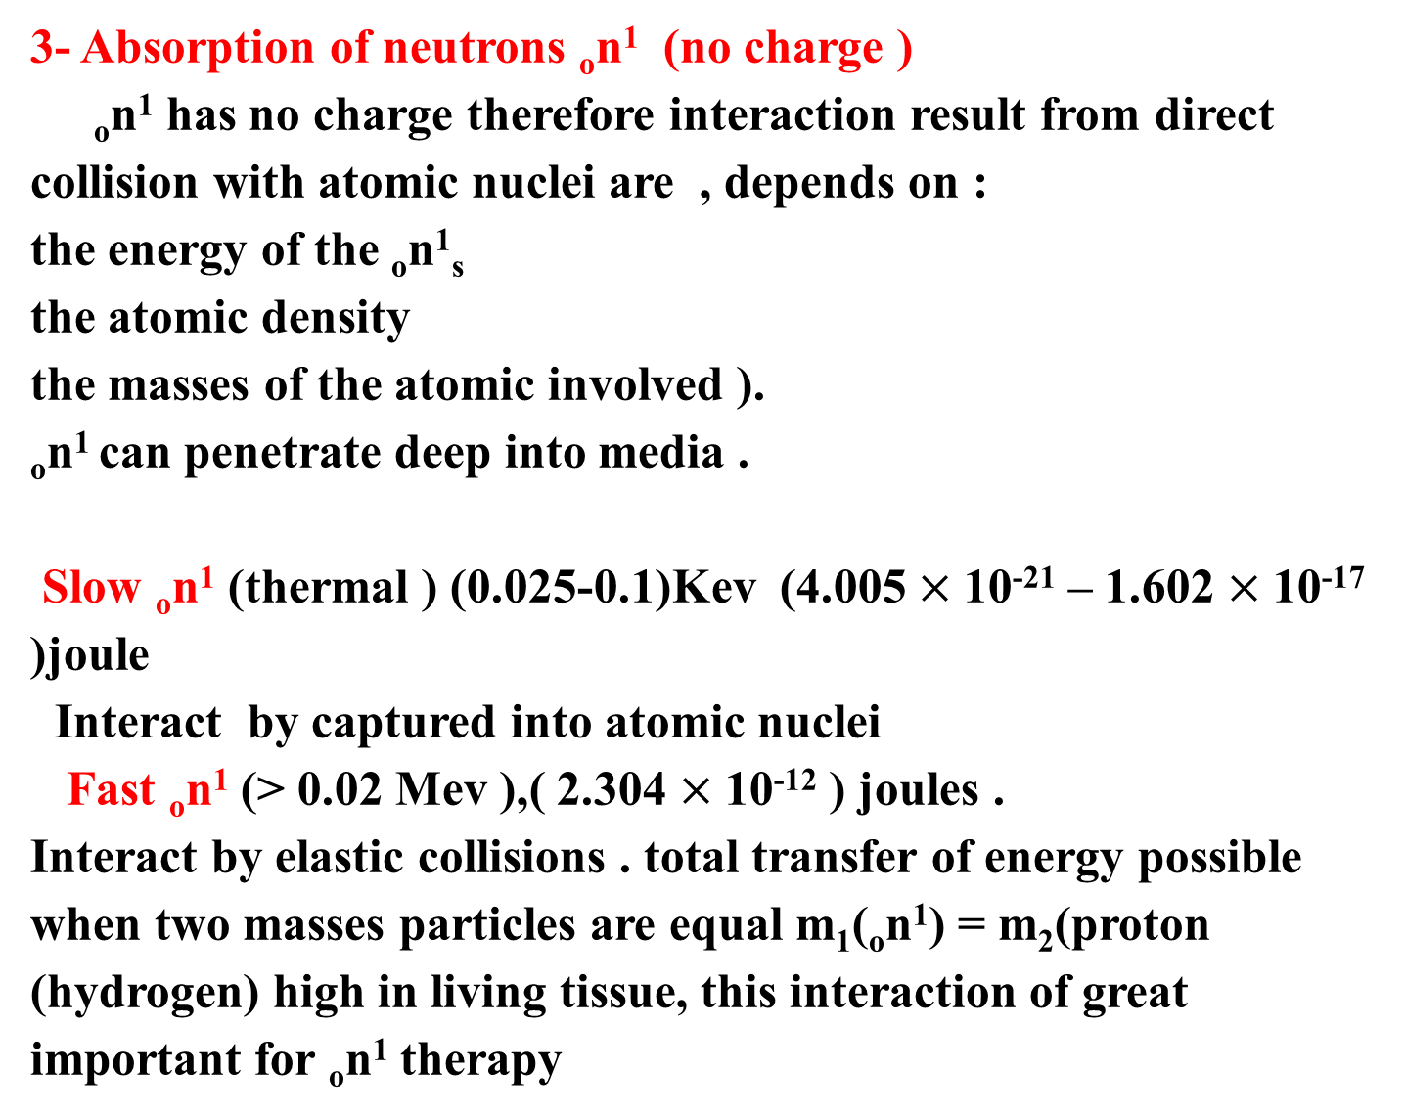
3- Absorption of neutrons _{o}n¹ (no charge )
_{o}n¹ has no charge therefore interaction result from direct collision with atomic nuclei are , depends on :
the energy of the _{o}n¹_{s}
the atomic density
the masses of the atomic involved ).
_{o}n¹ can penetrate deep into media .
Slow _{o}n¹ (thermal ) (0.025-0.1)Kev (4.005 $×$10⁻²¹ – 1.602 $×$10⁻¹⁷ )joule
Interact by captured into atomic nuclei
Fast _{o}n¹ (> 0.02 Mev ),( 2.304 $×$10⁻¹² ) joules .
Interact by elastic collisions . total transfer of energy possible when two masses particles are equal m₁(_{o}n¹) = m₂(proton (hydrogen) high in living tissue, this interaction of great important for _{o}n¹ therapy

Slide 26
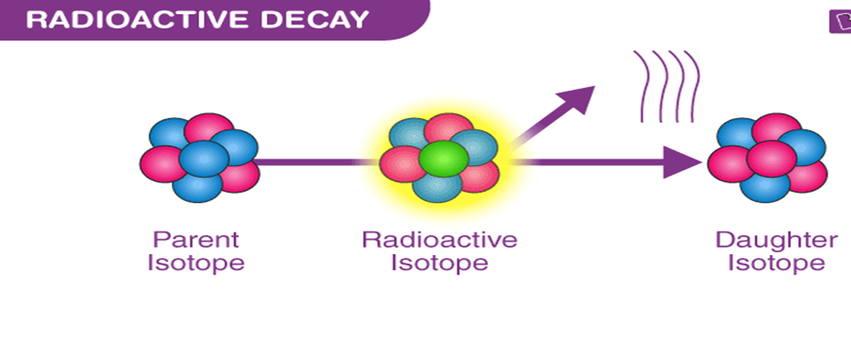
L31 - Radioactive Decay ,Half-life , Linear Energy Transfer (LET) and
Relative Biological Efficiency (RBE)
Radioactive Decay : is the random process in which a nucleus loses energy by emitting radiation. This is usually in the form of alpha particles (Helium nuclei), beta particles (electrons or positrons), or gamma rays (high energy photons). The nucleus' energy reduces, making it more stable.

Slide 27
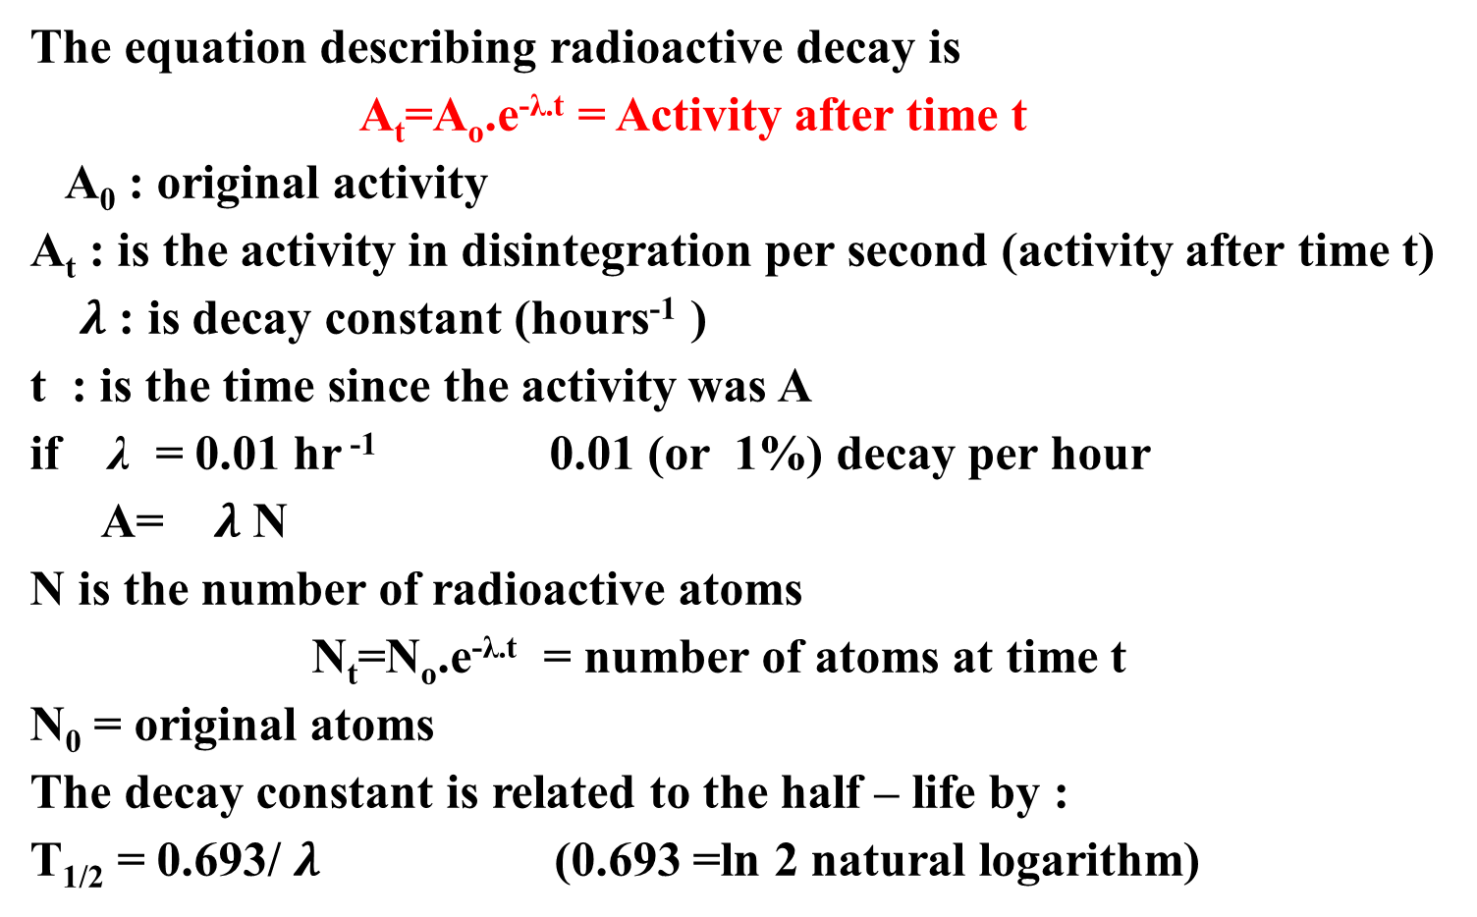
The equation describing radioactive decay is
A_{t}=A_{o}.e^{-λ.t} = Activity after time t
A₀ : original activity
A_{t} : is the activity in disintegration per second (activity after time t)
$λ$ : is decay constant (hours⁻¹ )
t : is the time since the activity was A
if λ = 0.01 hr ⁻¹ 0.01 (or 1%) decay per hour
A= $λ$ N
N is the number of radioactive atoms
N_{t}=N_{o}.e^{-λ.t} = number of atoms at time t
N₀ = original atoms
The decay constant is related to the half – life by :
T_{1/2} = 0.693/ $λ$ (0.693 =ln 2 natural logarithm)

Slide 28
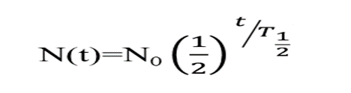
The half-life: is the amount of time it takes half of the atoms to release radiation and make the change from a very unstable configuration to a more stable configuration.
For example Iodine 131. It has a half life of eight days, uranium 238 has a half life of 4.5 billion years. It is because of this that it takes so long for an area that was nuked to get rid of the radiation; a lot of the elements used in nuclear weapons have much longer half-lifes.
A=A_{o}.e^{-λ.t} N=N_{o}.e^{-λ.t} A=-λ.N=dN/dt
N=N₀(1/2)^{m} m=(no. of half-life) since t=0 T_{1/2}=0.693/λ

Slide 29
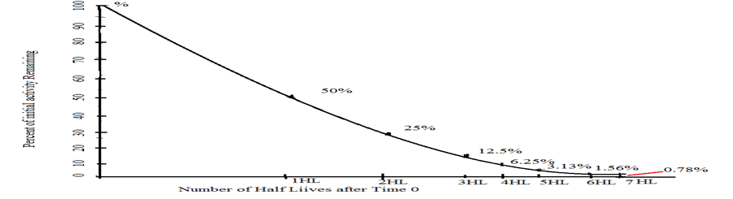
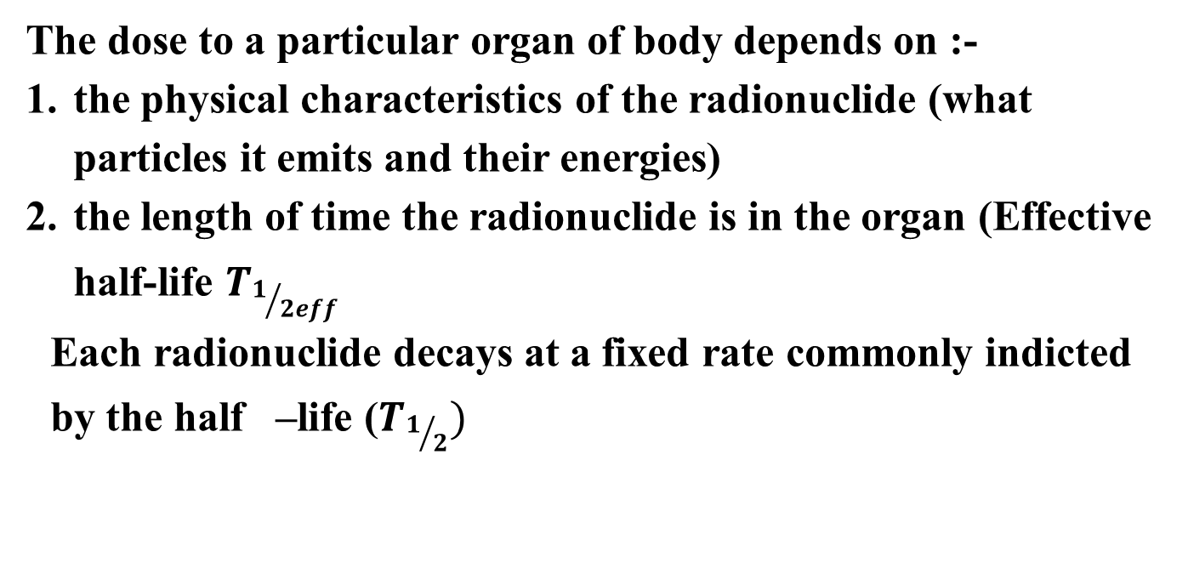
The dose to a particular organ of body depends on :-
the physical characteristics of the radionuclide (what particles it emits and their energies)
the length of time the radionuclide is in the organ (Effective half-life $T_{1/{{2eff}_{ } }}$
Each radionuclide decays at a fixed rate commonly indicted by the half –life ($T_{1/2})$

Slide 30
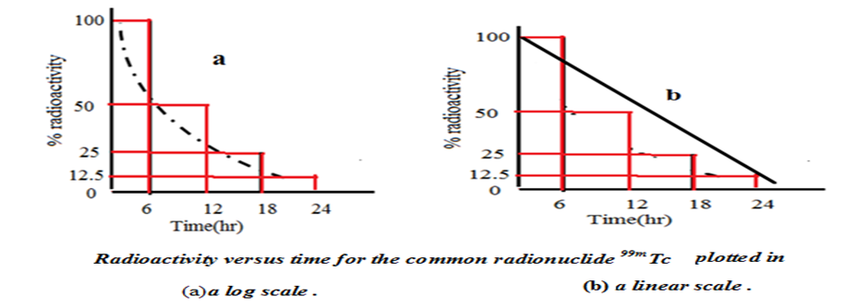
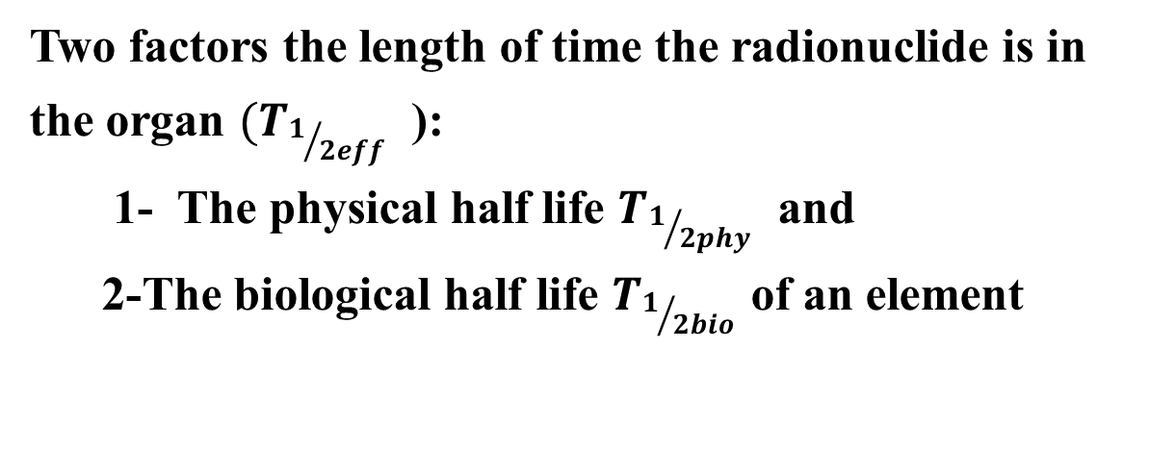
Two factors the length of time the radionuclide is in the organ $(T_{1/{{2eff}_{ } }}$):
1- The physical half life $T_{1/{{2phy}_{ } }}$ and
2-The biological half life $T_{1/{{2bio}_{ } }}$of an element

Slide 31
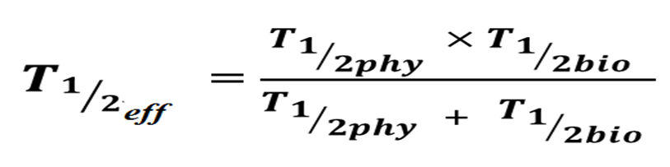
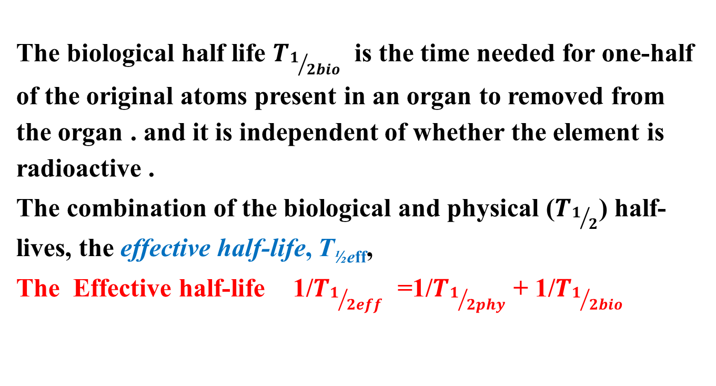
The biological half life $T_{1/{{2bio}_{ } }}$is the time needed for one-half of the original atoms present in an organ to removed from the organ . and it is independent of whether the element is radioactive .
The combination of the biological and physical ($T_{1/2}$) half-lives, the effective half-life, T_{½eff},
The Effective half-life 1/$T_{1/{{2eff}_{ } }}$ =1/$T_{1/{{2phy}_{ } }}$+ 1/$T_{1/{{2bio}_{ } }}$
Is less than either half-life and is calculated by the equation:-.

Slide 32
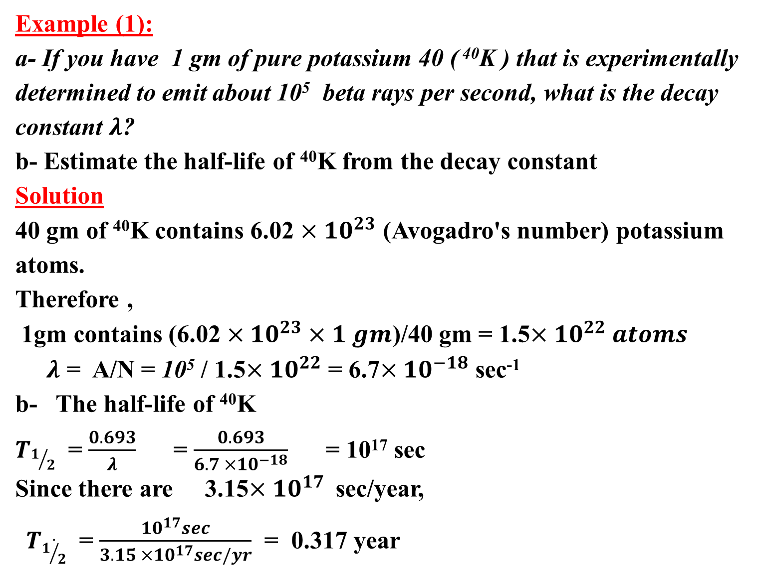
Example (1):
a- If you have 1 gm of pure potassium 40 ( ⁴⁰K ) that is experimentally determined to emit about 10⁵ beta rays per second, what is the decay constant $λ$?
b- Estimate the half-life of ⁴⁰K from the decay constant
Solution
40 gm of ⁴⁰K contains 6.02 $×{10}^{23}$ (Avogadro's number) potassium atoms.
Therefore ,
1gm contains (6.02 $×{10}^{23}×1 gm$)/40 gm = 1.5$×{10}^{22} atoms$
$λ$ = A/N = 10⁵ / 1.5$×{10}^{22}$ = 6.7$×{10}^{−18}$ sec⁻¹
b- The half-life of ⁴⁰K
$T_{1/2}$ = $\frac{0.693}{λ}$ = $\frac{0.693}{6.7 ×{10}^{−18}}$ = 10¹⁷ sec
Since there are 3.15$×{10}^{17}$sec/year,
${ T}_{\dot{1/2}}$ = $\frac{{10}^{17}sec}{3.15 ×{10}^{17}sec/yr}$ = 0.317 year

Slide 33
Linear Energy Transfer (LET) and
Relative Biological Efficiency (RBE)
Linear energy transfer (LET)
It describes how much energy an ionizing particle transfers to the material (transverse per unit distance).
Or the amount of energy a radiation deposits per unit of path length (i.e., kilo electron volts/micron - Kev/µm).
It describes the action of radiation into matter.
LET is a positive quantity, depends on the nature of the radiation as well as on the material traversed.

Slide 34
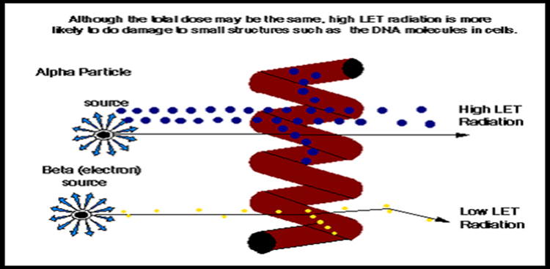
LET increases with the square of the charge on the incident particle. When ionizing radiation interacts within cells, it deposits ionizing energy in the cell .
The higher the charge of the particle and the lower the velocity, the greater likelihood to produce ionization.

Slide 35
Linear energy transfer (LET)
A measure of the rate at which energy is transferred from ionizing radiation to soft tissue
Mass, charge and velocity of a particle all affect the rate at which ionization occurs and is related to range. (Heavy, highly charged particles (e.g., α-particle) lose energy rapidly with distance and do not penetrate deeply.
In general, radiation with a long range (e.g., x-/γ-rays, high energy ß- particles) usually has a low LET,
While large particulate radiations with short range (e.g., α-particles, neutrons, protons) have a high LET.

Slide 36
LET is number of ionizations which radiation causes per unit distance as it traverses the tissue
Medical x-rays and gamma rays are low LET. LET of diagnostic x-rays is 3.0
Alpha particles are high LET - about 100.0
LET varies with type of radiation
LET is potential ionization

Slide 37
Relative Biologic Effectiveness, RBE
It is the ratio of biological effectiveness of one type of ionizing radiation relative to another, given the same amount of absorbed energy.
The RBE is an empirical value that varies depending on the particles, energies involved, and which biological effects are deemed relevant.
The higher the RBE of radiation, the more damaging is the type of radiation, per unit of energy deposited in biological tissues.

Slide 38
Different types of radiation have different biological effectiveness because they transfer their energy to the tissue in different ways
In tissue, the biologic effect of a radiation depends upon the amount of energy transferred to the tissue volume or critical target (i.e., the amount of ionization) and is therefore a function of LET.
Higher LET , higher ability to produced damage
In radiation biology research, many different types and energies of radiation are used and it become difficult to compare the results of the experiments based solely on LET

Slide 39
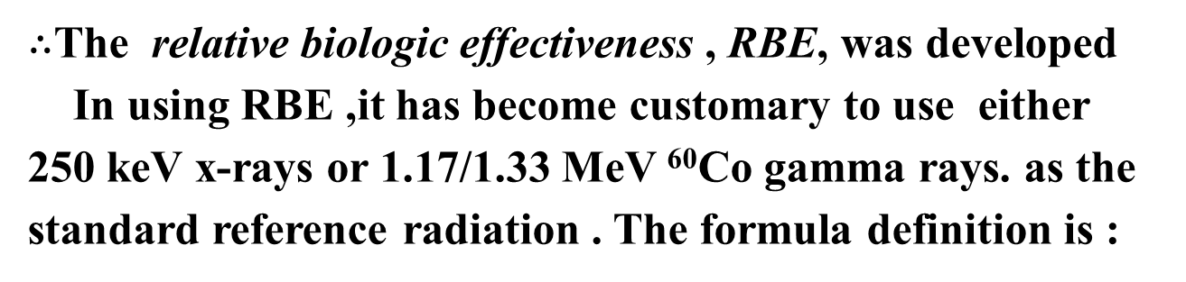

$∴$The relative biologic effectiveness , RBE, was developed
In using RBE ,it has become customary to use either 250 keV x-rays or 1.17/1.33 MeV ⁶⁰Co gamma rays. as the standard reference radiation . The formula definition is :
RBE = $\frac{Dose of standard radiation }{Dose of test radiation}$ For a given effect
For example, if 10 Gy of 60Co gamma rays kills 50 % of the mice in a group, and 1 Gy of heavy ion radiotherapy kills the other group, the RBE would be:
RBE = $\frac{Dose of standard radiation }{Dose of test radiation}$ =10/1 =10

Slide 40
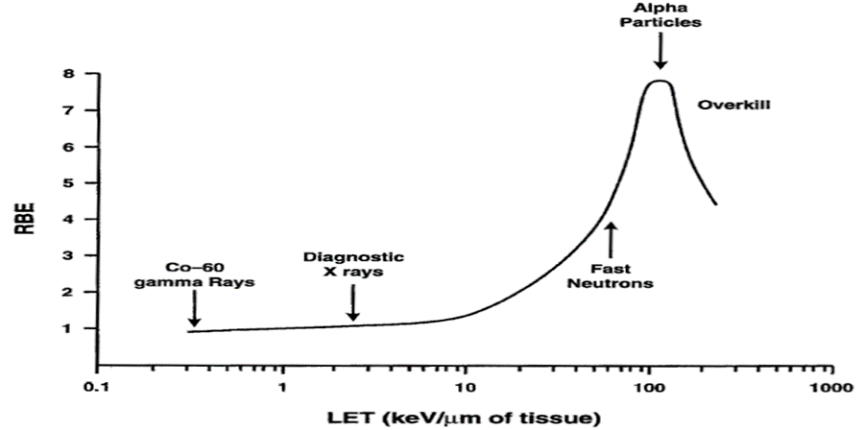
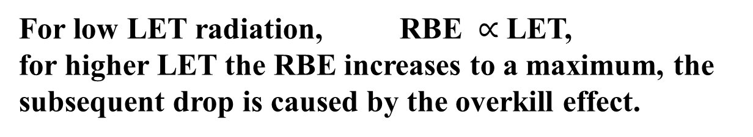
RBE is initially proportional to LET and, as the LET for ionizing radiation increases, so does the RBE.
For low LET radiation, RBE $∝$ LET,
for higher LET the RBE increases to a maximum, the subsequent drop is caused by the overkill effect.

Slide 41
Quality Factor (QF) (weighting factors)
Different types of radiation do different amounts of biological damage,
Quality factor of the radiation a factor express the effectiveness of the absorbed dose;
for ease of calculation, the QF of most of the radiation are:
Gamma Rays =1, Alpha Particles =20
X-rays =1, Thermal Neutron =3
β- Particles =1, Fast Neutron =10
The Quality Factor is used to modify the Absorbed Dose in Gray (Gy) by multiplying to obtain a quantity called the Equivalent Dose
Equivalent Dose = Quality Factor(RBE)* Absorbed Dose
D_{equiv} = RBE x D_{abs}

